Slide 1
Superconducting Qubits
Presented by Ini Ekpenyong Ukut and M Ikhsan Arif

Slide 2
Superconducting Qubits
Introduction
Definition of some terms
Periodic table of superconducting elements
Building artificial atoms
Quantum processor
Measurement
Dilution refrigerator
Towards quantum computing

Slide 3
Introduction
There are different technologies for creating qubits by exploring the quantum properties of natural atoms and manipulating artificial atoms for qubits. Such as Trapped ions, superconducting qubits, neutral atoms, topological qubits, diamond vacancies, and quantum dots. In this presentation, we will focus on superconducting qubits, though noisy, but easier to manipulate and scale if it is cooled at 15millikelvin and below. Before we dive into superconducting qubits, let us have a brief history of quantum revolutions.

Slide 4
Quantum revolution
Based on the understanding of quantum physics that led to the first revolution, where transistors and lasers were invented, being the building blocks of computers, the devices were built to follow the rules of quantum mechanics and basically is what forms today’s Information Technology.
Now in the second revolution, we can control individual quantum systems and exploit their properties such as superposition and entangling of qubits to do something useful. The second revolution comprises four technological pillars namely, quantum computing, quantum simulation, quantum sensing, and quantum communication. These are the technological inventions and creativity you can do if you have control of an individual quantum system.

Slide 5
Definition of terms
Before diving into superconducting qubits, it will be pertinent for us to understand some words that will be appearing more often in this presentation;
(A)Superconductors: These are substances that offer no resistance to the flow of electricity when current is applied.
(B)Qubits: These are quantum bits that represent two values at the same time: |0> and |1>, the smallest units of data in a quantum computer and communication and when we encode information in a quantum system we call it a qubit.
©Superposition: This is when we have |0> and |1> is represented at the same time. If we have two qubits, it will be represented by four numbers; |00>, |01>, |10>, and |11>. Generally, a register of N qubits can be represented by 2^{N} different states simultaneously.
(D)Entanglement: When two qubits in superposition are correlated with one another, meaning the state of one, whether it’s |0> or |1>depends on the state of another.

Slide 6
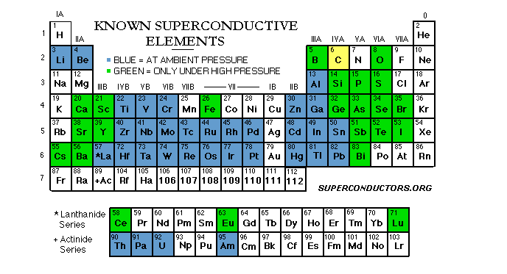
Periodic table of superconductive elements

Slide 7
Explanation of superconducting elements in the periodic table
The blue elements in the periodic table become superconducting at some temperature
The green elements become superconducting if you apply a pressure
In real life atoms are given to us freely by nature, we cannot easily alter their properties. Natural atoms are reliable, but they are not able to adapt to different functions and activities. Hence, we chose a technology that can adapt to the natural properties of atoms while also suitable for the construction of qubits.

Slide 8
Building artificial atom
In building artificial atoms there are certain criteria that must be met, as proposed by Physicist Prof DiVincenzo in 2000. These criteria are as follows:
(1) Initialization of the qubit to a simple state: The state must be prepared repeatedly with an acceptable error margin.
(2) Scalable Physical System with Well Characterized Qubit: We should be able to control more than one qubit and also know the total energy(potential and kinetic energy) in the system when the qubit is in a certain configuration.

Slide 9
Building artificial atom
(3) Long relevant coherence time: Qubit will lose its properties when interacting with the environment. So it must have a longer relevant coherence time during operation.
(4) Universal set of gates: Just like in classical computing where a set of gates can be combined to create other gates, so we want the same property in quantum computing to create another set of gates that can be used for many applications.
(5) Measurement of an individual qubit: After computation, we should be able to measure the qubit

Slide 10
Overview of qubit in the cloud
When we logged into our computer to learn, design, and run the algorithm in the system in the cloud, we are working on already created qubits from artificially created atoms. So, we will present in the next slide the workflow of the processes involved in the manipulation of qubits in the processor to give different gates on the Bloch sphere.

Slide 11

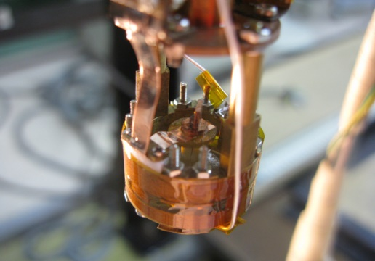
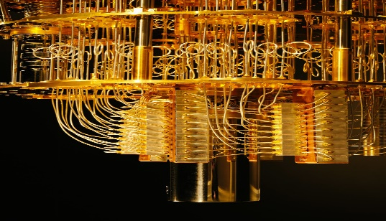
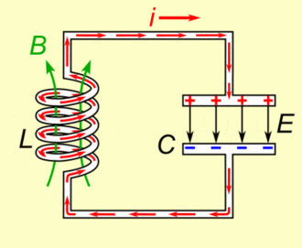
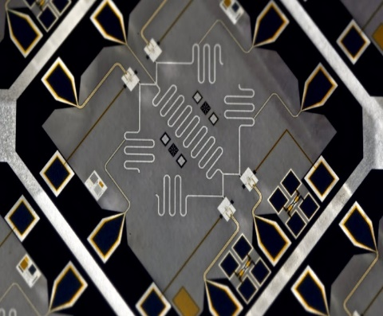
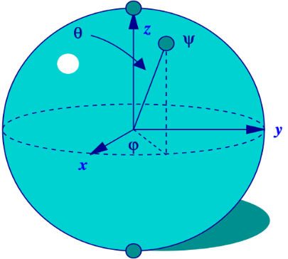
Big picture of qubits

Slide 12
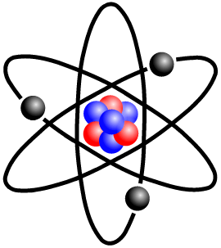
Classical circuits
For us to proceed to the quantum World, we first need to understand what is happening in the classical world by explaining what it constitutes. Below classical LC circuit explains

Slide 13
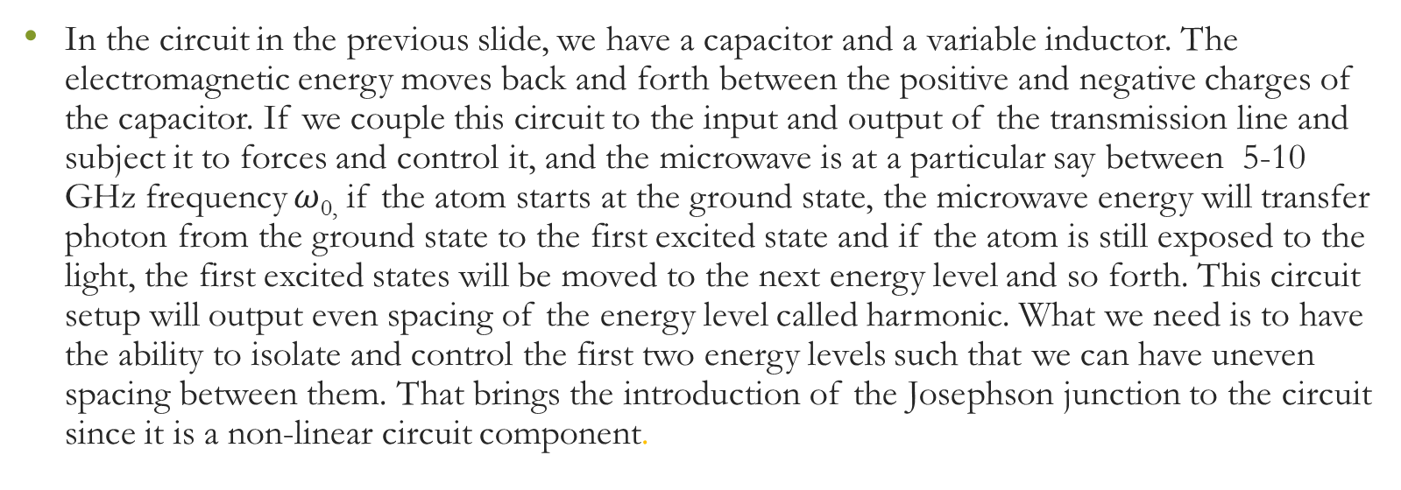
Explanation of a classical circuit
In the circuit in the previous slide, we have a capacitor and a variable inductor. The electromagnetic energy moves back and forth between the positive and negative charges of the capacitor. If we couple this circuit to the input and output of the transmission line and subject it to forces and control it, and the microwave is at a particular say between 5-10 GHz frequency $ω$_{0,} if the atom starts at the ground state, the microwave energy will transfer photon from the ground state to the first excited state and if the atom is still exposed to the light, the first excited states will be moved to the next energy level and so forth. This circuit setup will output even spacing of the energy level called harmonic. What we need is to have the ability to isolate and control the first two energy levels such that we can have uneven spacing between them. That brings the introduction of the Josephson junction to the circuit since it is a non-linear circuit component.

Slide 14
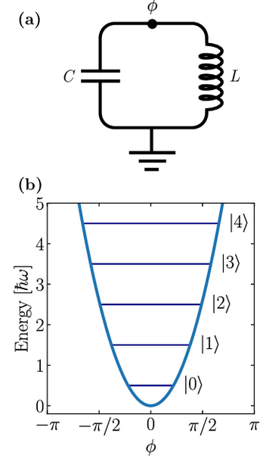
Evenly spaced harmonic oscillator
(source: Rasmussen, S. & Christensen, K. & Pedersen, S. & Kristensen, L. & Bækkegaard, T. & Loft, N. & Zinner, N.. (2021). The superconducting circuit companion -- an introduction with worked examples.)

Slide 15
Explanation of classical circuit with Josephson tunnel junction
For us to achieve non-linearity, a tunable inductor is introduced into the circuit such that its inductance will change as a function of how much energy is stored in it and that will open up the potential and allow us to isolate the atom of the qubits in the lowest two energy levels. If we do that we can have a multi-level system and confine all dynamics to the two lowest quantum levels that will then give us the needed qubits. The inductive energy for the junction is not quadratic, but a cosine function of the generalized flux through it. Josephson junction qubit circuit, where the linear inductor has been replaced by a non-linear Josephson junction of energy EJ. The Josephson junction changes the harmonic potential (blue dashed) into a sinusoidal potential (orange solid), yielding non-equidistant energy levels.

Slide 16
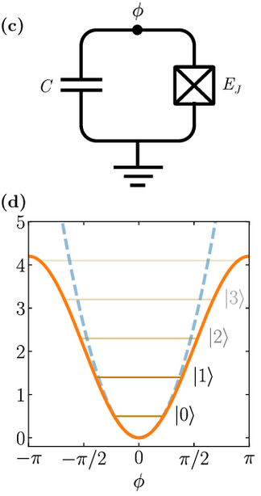
Superconducting circuitry with Josephson junction
(source: Rasmussen, S. & Christensen, K. & Pedersen, S. & Kristensen, L. & Bækkegaard, T. & Loft, N. & Zinner, N.. (2021). The superconducting circuit companion -- an introduction with worked examples.)

Slide 17
Functions of different components in the circuit
The capacitor and inductor are coupled to build qubit circuits, where its energy state is manipulated to create a superposition of |0> and |1>
A Josephson junction in the circuit is made up of a superconducting electrode, and other superconducting electrodes to allow copper pairs to tunnel across a thin insulating barrier and behaves as a nonlinear element which in turn produces quantum mechanical energy levels that are unevenly spaced. Here, we notice a deviation from the normal harmonic oscillator that has evenly spaced energy levels, which is good for our system because it permits the isolation of two energy levels to provide the computational basis for <0| and <1| for a qubit.

Slide 18
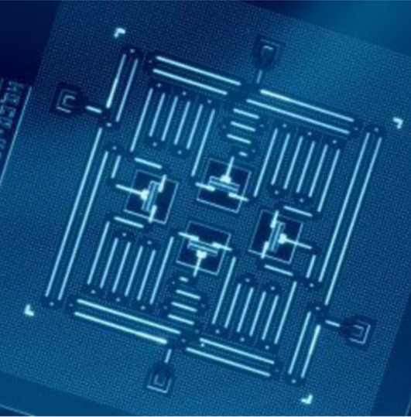
Transmon Qubit
Superconducting qubits differ in two important ways from truly quantum two-level systems such as the spin of an electron or the spin of certain nuclei. First, they are multi-level systems. Second, these qubits are fabricated circuits. A sample is shown in below.
A device consisting of four transmon qubits, four quantum busses, and four readout resonators fabricated at IBM and appears in the paper "Building logical qubits in a superconducting quantum computing system" by Jay M. Gambetta, Jerry M. Chow, and Matthias Steffen. (npj Quantum Information (2017) 3:2 ; doi:10.1038/s41534-016-0004-0)

Slide 19
Transmon Qubits
A diagram or picture and video are needed here(Video 38” and above)
When an electric field is applied across them it creates a displacement between the two islands. On the right, you have a net positive charge and a net negative charge of say 10 ⁻¹² mobile electrons on the left. Since the temperature is low, the electrons will condense into a superconducting pair called cooper pairs and they moved without dissipation
Let the charges on the different islands be +Q(t) and -Q(t). The charge will generate an electric field E(r,t).

Slide 20
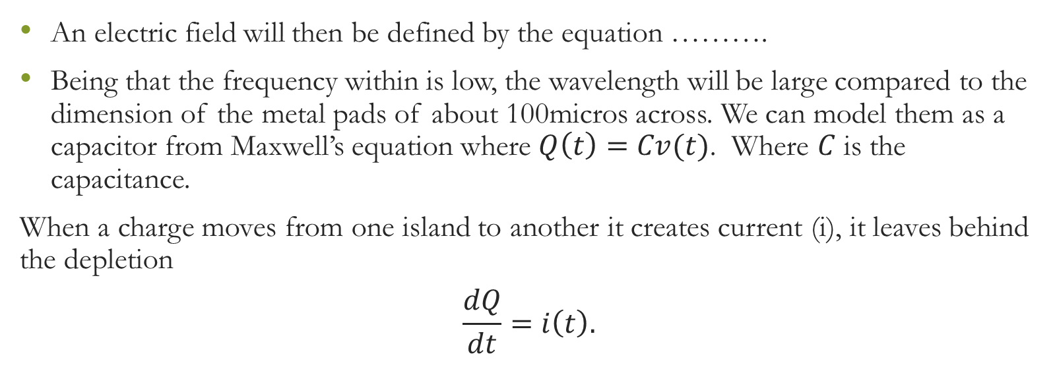
Transmon Qubit
An electric field will then be defined by the equation ……….
Being that the frequency within is low, the wavelength will be large compared to the dimension of the metal pads of about 100micros across. We can model them as a capacitor from Maxwell’s equation where $Q\left(t\right)=Cv(t)$. Where $C$ is the capacitance.
When a charge moves from one island to another it creates current (i), it leaves behind the depletion
$$\frac{dQ}{dt}=i\left(t\right).$$

Slide 21
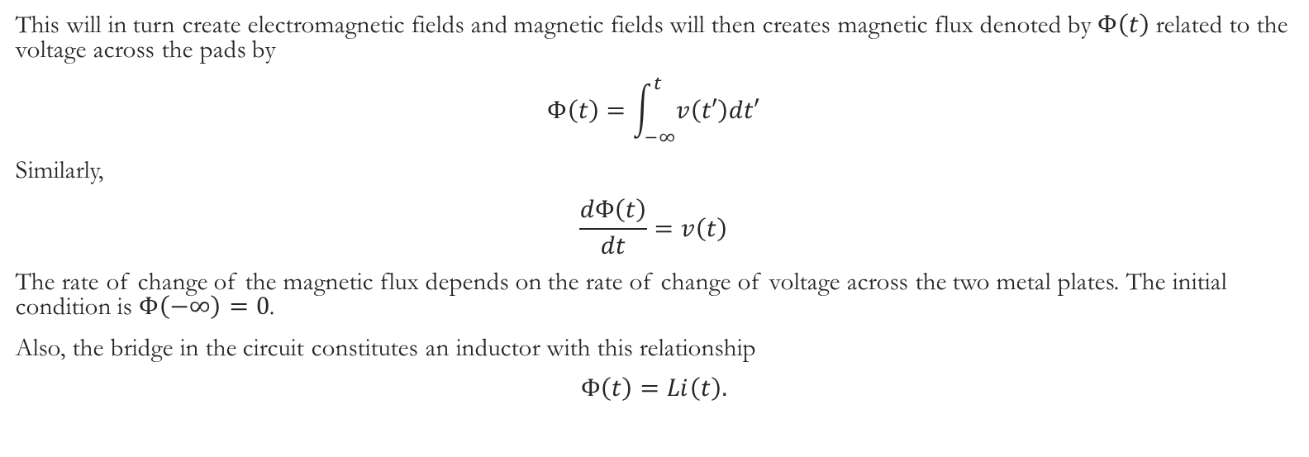
Transmon Qubit
This will in turn create electromagnetic fields and magnetic fields will then creates magnetic flux denoted by $Φ\left(t\right)$ related to the voltage across the pads by
$$Φ\left(t\right)=\int_{−∞}^{t}{v\left(t′\right)dt′}$$
Similarly,
$$\frac{dΦ\left(t\right)}{dt}=v\left(t\right)$$
The rate of change of the magnetic flux depends on the rate of change of voltage across the two metal plates. The initial condition is $Φ\left(−∞\right)=0$.
Also, the bridge in the circuit constitutes an inductor with this relationship
$$Φ\left(t\right)=Li\left(t\right).$$

Slide 22
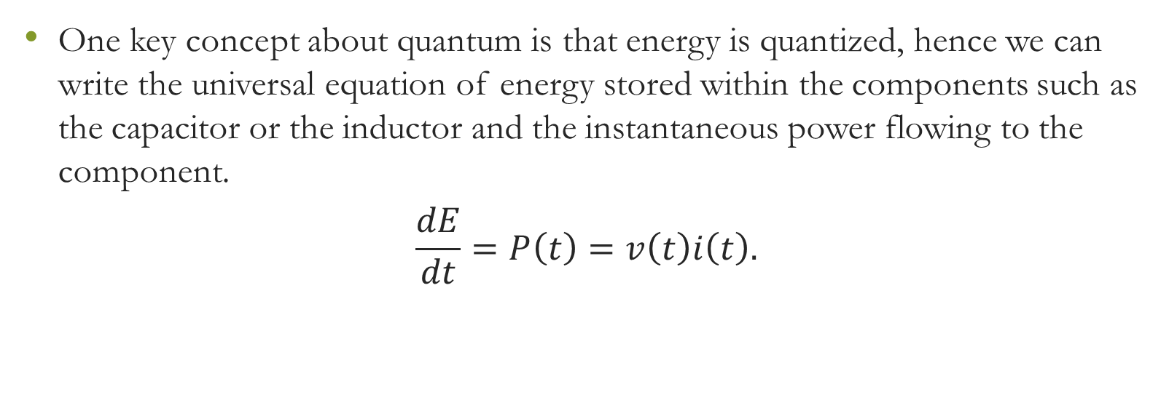
Transmon qubit
One key concept about quantum is that energy is quantized, hence we can write the universal equation of energy stored within the components such as the capacitor or the inductor and the instantaneous power flowing to the component.
$$\frac{dE}{dt}=P\left(t\right)=v\left(t\right)i\left(t\right).$$

Slide 23
Qubit measurement with circuit
To implement many types of quantum information processing operations, several spatially separated qubits need to interact with each other to produce entanglement.
Circuit QED systems address this by coupling qubits to transmission line structures. Often, these transmission lines will be resonators that can be used as a quantum “bus” to connect different qubits to each other or as part of a measurement chain to read out the quantum states of the qubits.

Slide 24


Quiz
Click the Quiz button to edit this object

